Slide 1



UNIT 4: So much to do, so little time
Changing the world

Slide 2
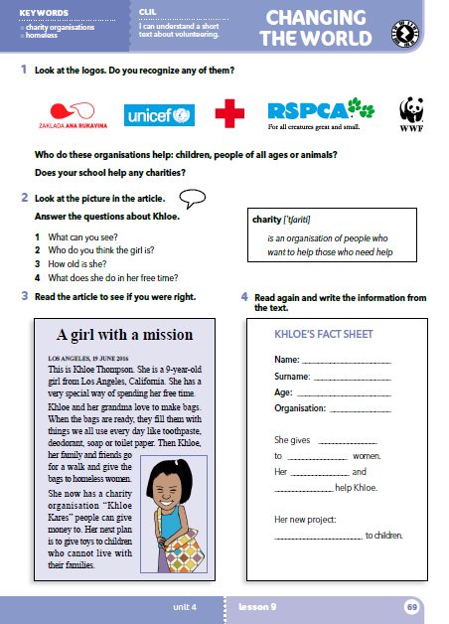

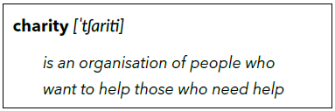
Do you recognize any of these logos?
What is a charity?
Who do they help: children, people of all ages or animals?
Does your school help any charities?
dobrotvorna organizacija

Slide 3
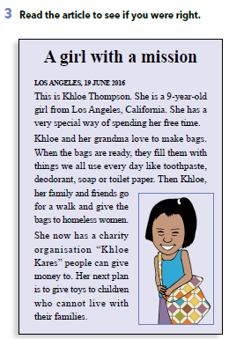
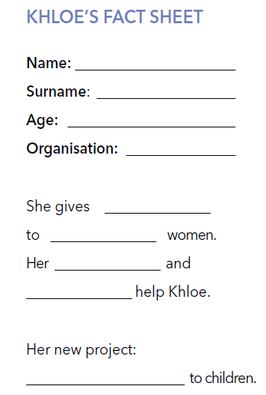
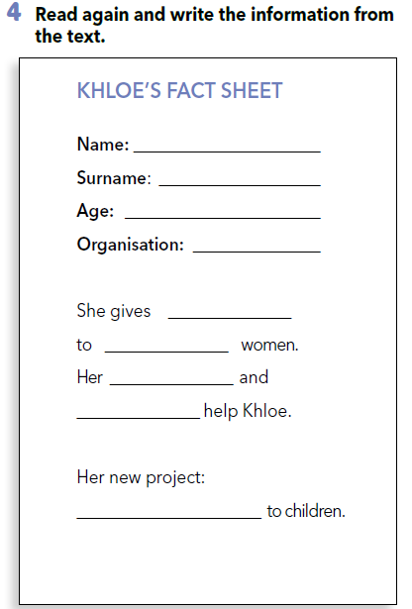
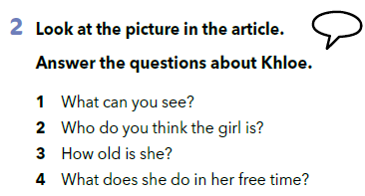
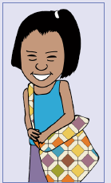
Khloe
Thompson
9
”Khloe Kares”
Što vidiš na slici?
bags
Tko je ta djevojčica?
homeless
Koliko ima godina?
family
friends
Čime se bavi u slobodno vrijeme?
give toys

Slide 4
What do you think about Khloe?
Do you think her work is important?
Do you think her work is dangerous?
Do you know anyone who helps people in some way?
Do you know anyone who helps animals in some way?

Slide 5
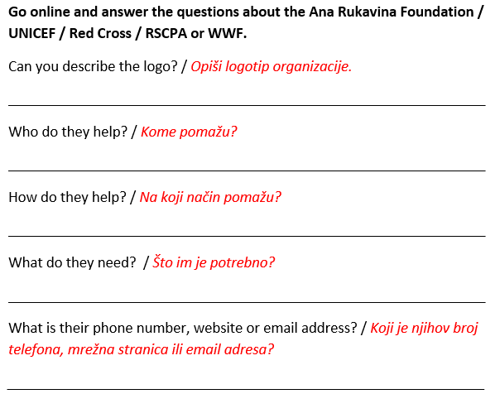

Slide 6
Check your knowledge.
https://learningapps.org/watch?v=pqe9x93d318
https://wordwall.net/play/256/631/132

Slide 7
What can you remember about Khloe?
Where is she from?
How old is she?
What does she do?
What can you remember about:
Ana Rukavina Foundation?
UNICEF?
Red Cross?
RSPCA?
WWF?
Who do they help? How?
Is there anyone in this town/country who needs help?
Would you like to help someone? How?
What do you need to help them?
Would you like to change something? How?

Slide 8
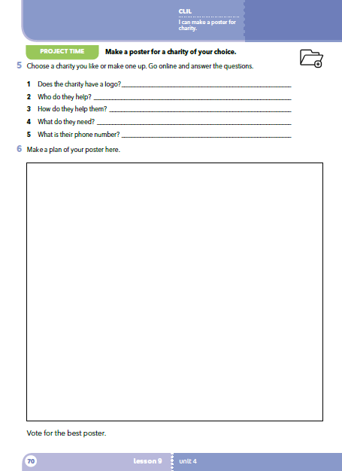
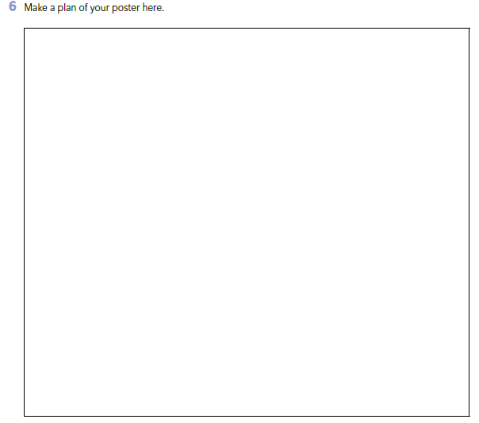
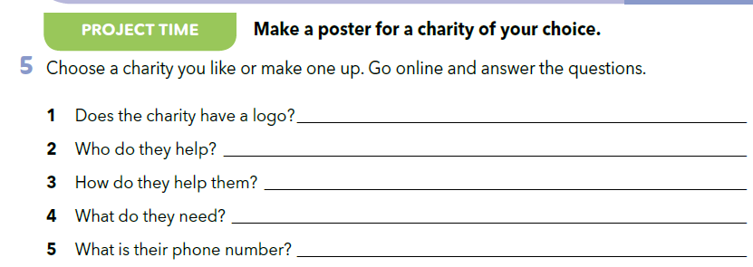
PROJECT TIME
Ima li dobrotvorna organizacija logotip?
Kome pomažu?
Na koji način im pomažu?
Što im je potrebno?
Koji je njihov broj telefona?

Slide 9
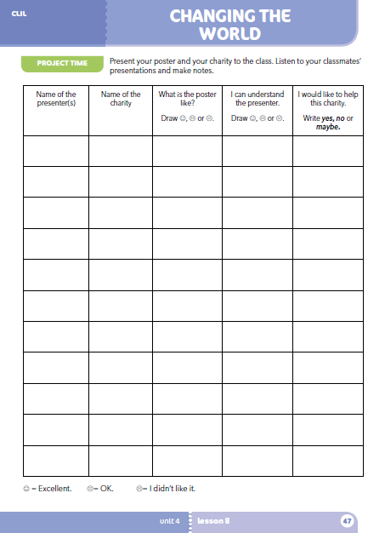
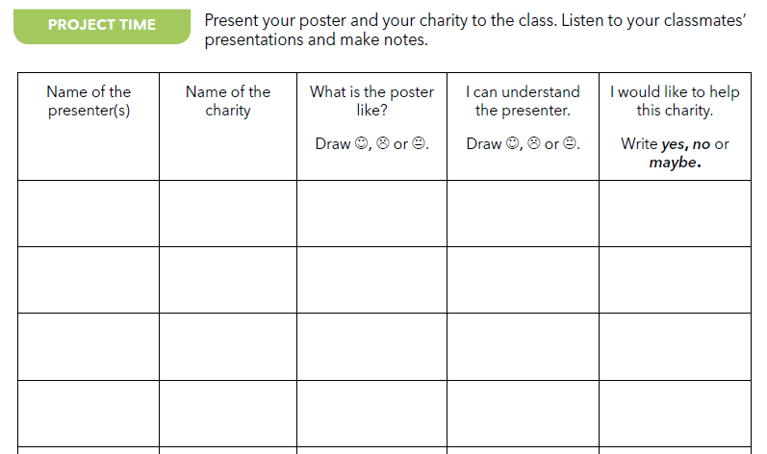
Workbook p 47.

Slide 10
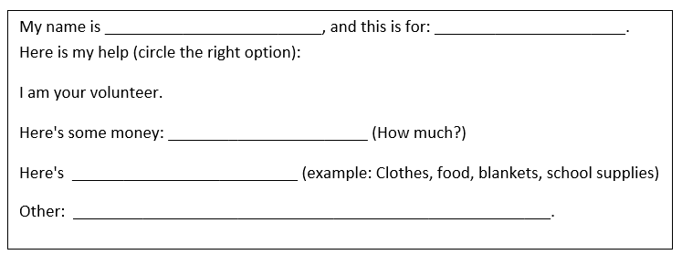
(naziv organizacije)
Ovo je moj način pomoći (zaokruži točnu opciju)
Ja sam volonter.
Doniram novac: _________ (iznos)
Doniram: _____________________ ( npr.: odjeća, hrana, deke, školski pribor.)
Nešto drugo:
I decided to help __________________, because __________________.

